Slide 1
INTRUSION DETECTION SYSTEM
An intrusion detection system (IDS) is a device or software application that monitors a network or systems for malicious activity or policy violations.
Any intrusion activity or violation is typically reported either to an administrator or collected centrally using a security information and event management (SIEM) system.
A SIEM system combines outputs from multiple sources and uses alarm filtering techniques to distinguish malicious activity from false alarms.

Slide 2
How Intrusion Detection System Works?
Intrusion detection systems can be either network- or host-based.
A host-based intrusion detection system is installed on the client computer, while a network-based intrusion detection system resides on the network.
Intrusion detection systems work by either looking for signatures of known attacks or deviations from normal activity.
These deviations or anomalies are examined and then IDS can effectively detect events such as Christmas tree scans and domain name system (DNS) poisonings.

Slide 3
Datasets That We Can Use:
UNSW-NB15 network dataset
KDD Cup 1999 Data
The Bot-IoT Dataset
DARPA Dataset
Other Datasets Research Paper : Link

Slide 4
Types Of Dataset
Packet Based Dataset
Flow Based Dataset

Slide 5
Packet - Based Dataset
Packet-based data is commonly captured in pcap format and contains payload.
Available metadata depends on the used network and transport protocols.
There are many different protocols and the most important ones being TCP, UDP, ICMP and IP.

Slide 6
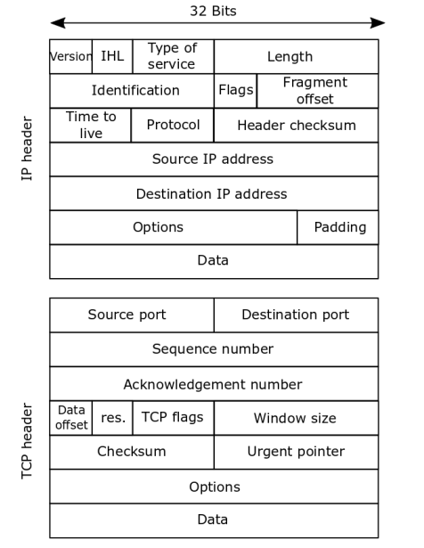
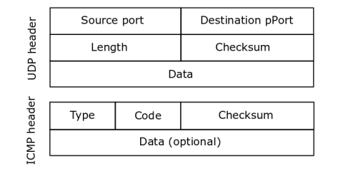

Slide 7
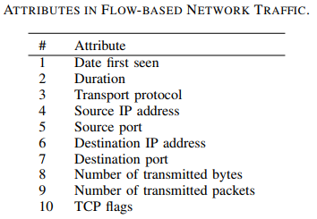
Flow - Based Dataset
Flow-based network data is a more condensed format which contains mainly meta information about network connections.
Flow-based data aggregate all packets which share some properties within a time window into one flow and usually do not include any payload.
The default five-tuple definition, i.e., source IP address, source port, destination IP address, destination port and transport protocol

Slide 8
How we will implement (based of reference #3 in last slide)
Dataset:
We used the KDD 1999 intrusion detection competition sataset.
Pre-Processing:
The dataset was labelled on individual connection records whether it is normal or attack.
In the dataset the derived features are denoted as discrete types like eg. Tcp, ftp,sf as 5, 0.01, etc.
So dataset is preprocessed to correspond with input form of SVM

Slide 9
Learning :
Through training, SVM became a decision model.
Training set was used to generate decision function of SVM and validation set was used to evaluate the decision function.
If the detection rate was too low, new learning process must be done.
The different C values used are 1, 100, 500, 1000
The different kernel functions used are linear, 2-poly, RBF(radial basis function)
Testing :
In test set, there are 14 types of different tests which were not conatained in training set.
So the performance of the model is tested accordingly on the test data.

Slide 10
Conclusion :
In this , we used a labelled dataset and performed 3 kinds of experiments and proved that SVM IDS is a good choice for IDS.
This can be applied in real-time using a hardware based SVM-IDS chip to process it faster than software.
For the mis-classfications, we can use Genetic Algorithm based feature extraction or Decision Tree method so that performance can be improved.

Slide 11
Drawbacks :
Due to SVM:
Choosing a good kernel is not easy in SVM.
We may be needed to run it multiple times with different hyperparameters to get the desired result.
It is also prone to over-fitting.
Due to Network Based Approach:
Processing the large no. of packets is not feasible.
It cannot analyse encrypted information as that can only be detected by device for which it is sent.

Slide 12
References:
1. A Survey of Network-based Intrusion Detection Data Sets 2. NetSTAT: A Network-based Intrusion Detection Approach 3. Network-Based Intrusion Detection with Support Vector Machines
4. RT-UNNID: A practical solution to real-time network-based intrusion detection using unsupervised neural networks

